Slide 1
Traveling Salesperson Problem using Dynamic Programming

Slide 2
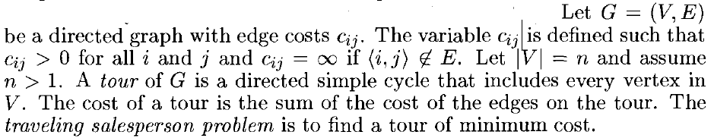
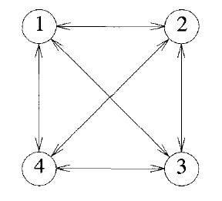
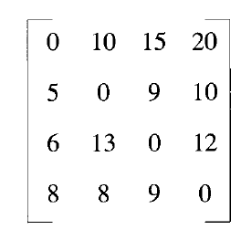
Traveling Salesperson Problem

Slide 3
Traveling Salesperson Problem
1
2
3
4
3
4
2
4
2
3
Possible tours for the above graph..
1-2-3-4-1
1-2-4-3-1
1-3-2-4-1
1-3-4-2-1
1-4-2-3-1
1-4-3-2-1
4
3
4
2
3
4
n=4
n! =4! = 24 tours
Each source generates 6 tours.

Slide 4






Traveling Salesperson Problem
1
2
3
4
3
4
2
4
2
When |S|< n-1
3
When |S|= n-1
4
3
4
2
3
4
Calculations should start from
|S|=0
|S|=1 , |S|=2 and soon |S|=n-1

Slide 5
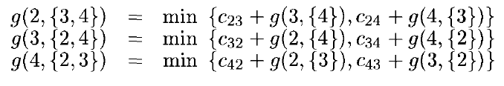
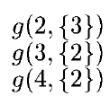
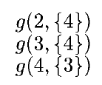



Traveling Salesperson Problem
1
2
3
4
3
4
2
4
2
3
4
3
4
2
3
4

Slide 6
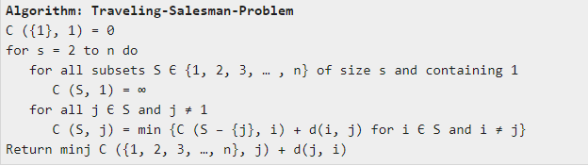
Algorithm

Slide 7

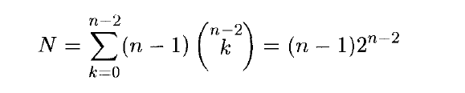



Traveling Salesperson Problem
For one vertex

Slide 8


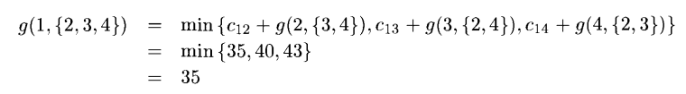
|S|=0
J (2,Ø) = 1 J (3,Ø) = 1 J (4,Ø) = 1
|S|=1
J ( 2, {3} ) = 3 J (2,{4}) = 4
J ( 3, {2} ) = 2 J (3, {4}) = 4
J ( 4, {2} ) = 2 J (4, {3}) = 3
|S|=2
J (2,{3,4}) = 4
J ( 3, {2,4} ) = 4
J (4, {2,3})= 2
|S|=3
Minimum tour cost is 35 and path is 1-2-4-3-1
J (1,{2,3,4}) = 2
J (2,{3,4}) = 4
J (4,{3}) = 3
J (3, Ø) = 1
1
2
4
3
1

Slide 9
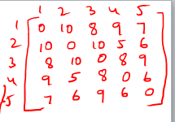
Problem

